Slide 1
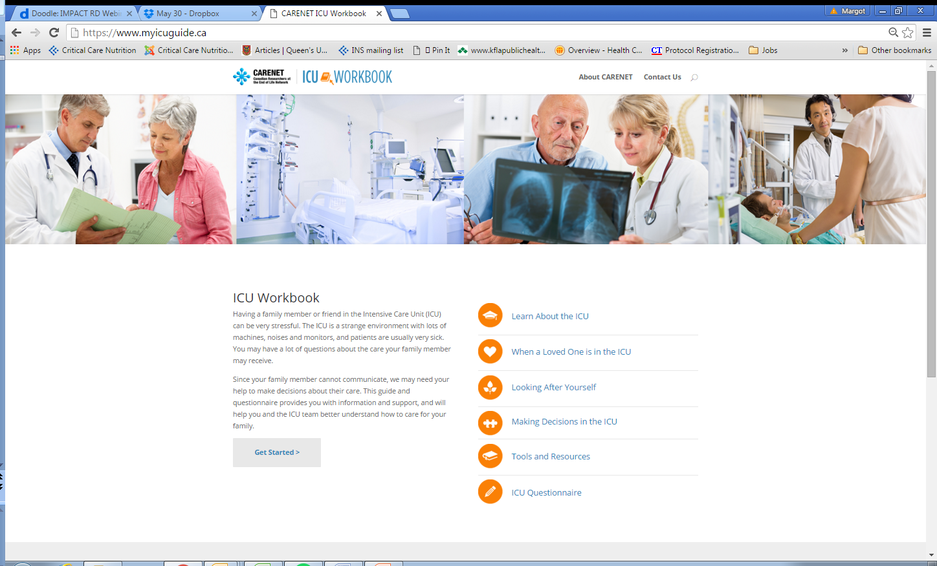

The Evolving Role of “Family” in the Care of Critically Ill Patient
Daren K. Heyland
Professor of Medicine
Queen’s University, Kingston General Hospital
Kingston, ON Canada

Slide 2
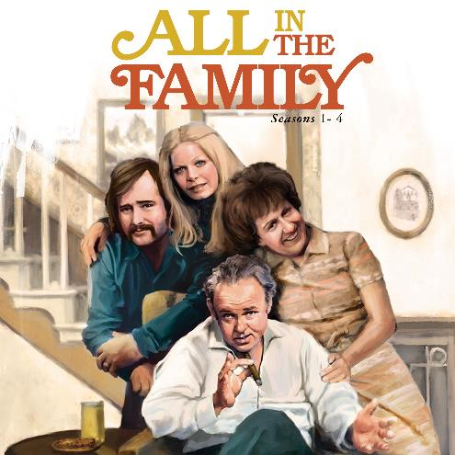


Slide 3
The Evolution of “Family” in the Care of Critically Ill Patients
ERA
Families’ Experience
Family Satisfaction with ICU (FS-ICU 24R)
SCCM Guidelines for Family-Centered Care in the ICU
Family Centered
Care
Family as “Partners’
Improving Partnerships with Family Members of ICU Patients: The IMPACT Trial

Slide 4
Conceptual Framework for Quality of Care
PATIENT FACTORS
STRUCTURE AND PROCESSES OF CARE
OUTCOMES
PERSONAL AND SOCIAL ENVIRONMENT
Patient and Family situation
Clinical status, casemix
Social support for patient
Social support for family
STRUCTURE OF CARE
Access to care within system
Organization of care
Formal support services available
Physical environment(s) of care
PROCESS OF CARE WITH PHYSICIANS, NURSES, SOCIAL WORKERS
Technical processes with patient
Decision-making processes with patient and family
Information, counseling of patient and family
Interpersonal and communication style with patient and family
SATISFACTION WITH HEALTH CARE
Patient satisfaction with care
Family satisfaction with care
QUALITY AND LENGTH OF LIFE
Quality of life of patient
Quality of life of family and loved ones
Quality of dying of patient
Length of life
Stewart J Pain and Symptom Management 1999:17:93

Slide 5
Why Measure Family Satisfaction?
Patient and family centered outcomes recognized as important outcome measures
Increasing accountability for public use of funds in health care sector
Traditional measures (adjusted mortality rates, LOS) do not tell the whole story

Slide 6

When performance is measured,
performance improves.
When performance is
measured and reported back,
the rate of improvement accelerates.
Thomas Monson

Slide 7

A Critical Incident

Slide 8
Family Satisfaction in the ICU:
Conceptual Development
Items generated from published studies related to:
  Patient satisfaction
  Quality end of life care
  Existing literature on family (dis)satisfaction
  Medical decision making

Slide 9
Family Satisfaction in the ICU (FS-ICU)
Most popular and rigorously developed questionnaire to measure the family’s experience
2 versions
  FSICU-24
  FSICU-34
>30 published studies
Translated and/or culturally adapted to 15 languages
Existing databases used to provide bench-marking
For more information, see www.fsicu.org

Slide 11
Translated into Russian thanks to Vladimir Lomivorotov
See FSICU.org

Slide 12
Family Satisfaction Benchmarked Site Report

Slide 13
Family Satisfaction Benchmarked Site Report

Slide 14
Family Satisfaction Benchmarked Site Report

Slide 15
Targets for Quality Improvement
Focus on the items considered ‘most important’ and families are ‘least satisfied’ (Quadrant A)
Dodek
CCM 2004

Slide 16
Don’t forget to capture the stories!

Slide 17

My Quality Improvement Motto
Facts provide us with knowledge;
Stories provide us with the power to transform care!

Slide 18
Relationship between
“Family Satisfaction” and long-term outcomes
Family dissatisfaction may be a modifiable determinant to their long-term psychological well-being
Zimmerli Resuscitation 2014

Slide 19
The Evolution of “Family” in the Care of Critically Ill Patients
ERA
Families’ Experience
Family Satisfaction with ICU
(FS-ICU 24R)
SCCM Guidelines for Family-Centered Care in the ICU
Family Centered
Care
Family as “Partners’
Improving Partnerships with Family Members of ICU Patients: The IMPACT Trial

Slide 20
The Institute of Medicine defines quality care as safe, timely, efficient, effective, equitable, and patient-centered
In the ICU, patient-centeredness includes family-centeredness

Slide 21
Provider centric
Focus on disease treatment
Patient Centric
Focus on evaluation and
treatment of patients
Notes:
In fact, in the last few decades, healthcare has been characterized by a provider-centered model [2] with an emphasis on the evaluation and treatment of diseases rather than the evaluation and treatment of patients. These and other characteristics of PCM, compared with those of traditional clinical medicine, are summarized in Table 1.

Slide 22
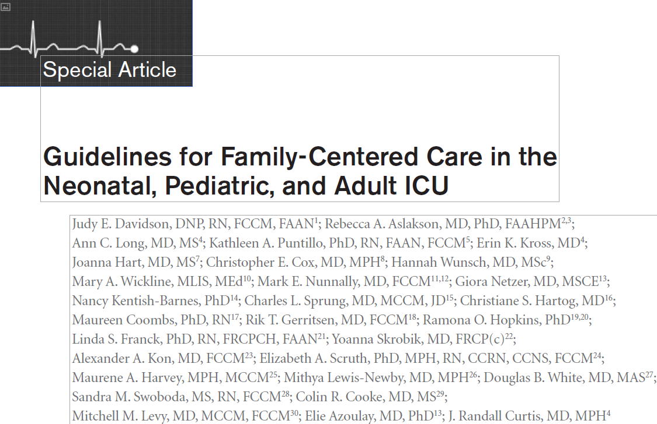
Davidson CCM 2017 Jan epub

Slide 23
Definitions
Family is defined by the patient or, in the case of minors or those without decision-making capacity, by their surrogates. In this context, the family may be related or unrelated to the patient. They are individuals who provide support and with whom the patient has a significant relationship.
Family-centered care is an approach to health care that is respectful of and responsive to individual families’ needs and values.
Notes:
Notice that we defined family-centered care. The scope of these guidelines are to explain best practices in caring for the family members of ICU patients. It is not how to provide person-centered care, which would have been a project much larger in scope.
We purposefully focused as tightly as possible on how to provide care that is family oriented.
We purposefully reached out to the LGTBQ community to assure that the definitions would work across the gender spectrum

Slide 24
Guidelines for Family-Centered Care in the ICU
Reviewed 286 qualitative and quantitative papers
Summarized data across numerous topics
Generated 23 recommendations
All recommendations were ‘weak’ highlighted the nascence of this field of research
Important to generate new research to strengthen the evidentiary foundation
Davidson CCM 2017 Jan epub

Slide 25
Guidelines for Family-Centered Care in the ICU
An example
Family Presence in the ICU
Families be offered
  Open and flexible family presence
  Option to participate in rounds
  Option of being present during resuscitation efforts
Davidson CCM 2017 Jan epub

Slide 26
Guidelines for Family-Centered Care in the ICU
Family Support
Family education programs be included as part of clinical care
Peer to peer support be implemented
ICUs provide families with leaflets that give information about the ICU setting to reduce family member anxiety and stress
Davidson CCM 2017 Jan epub

Slide 27
Guidelines for Family-Centered Care in the ICU
Family Support cont’d
ICU diaries be implemented
Validated decision support tools be implemented to optimize quality of communication, comprehension and reduce decisional conflict
Amongst surrogates of ICU deemed to have poor prognosis, clinicians use a structured communications approach (such as VALUES)
Davidson CCM 2017 Jan epub

Slide 28
Guidelines for Family-Centered Care in the ICU
Communication with family members
Routine interdisciplinary family conference
Structured approaches to communication
For family members of patients who are dying, offered a written bereavement brochure
ICU clinicians receive family-centered communication training as part of their core critical care training
Davidson CCM 2017 Jan epub

Slide 29
Guidelines for Family-Centered Care in the ICU
Use of specific consultation and ICU team members
Proactive palliative care consultation among selected patients with poor prognosis
Ethics consults for whom there is value-related conflict
Social workers be included and participate in family meetings
Family navigators (care coordinator or communication facilitator
Spiritual support where needed
Davidson CCM 2017 Jan epub

Slide 30
Guidelines for Family-Centered Care in the ICU
Operational and environmental issues
Protocols be implemented to ensure adequate and standardized use of sedation and analgesia during withdrawal of life supports
Nurses be involved in decision-making goals and be training to provide support in decision-making
Hospital implement policies to promote family-centered care in the ICU, reduce noise, promote hygiene, and increase use of private rooms.
Families be provided a sleep surface
Davidson CCM 2017 Jan epub

Slide 31
SCCM FCC Gap Analysis Tool
A free tool that evaluates your practice against recommended practice
Creates a priority list for change
Assess barriers to change
Develop an feasible organization-specific bundle to enhance FCC in your ICU
Notes:
This tool will help you build an ICU or organization-specific bundle for action-planning.

Slide 32
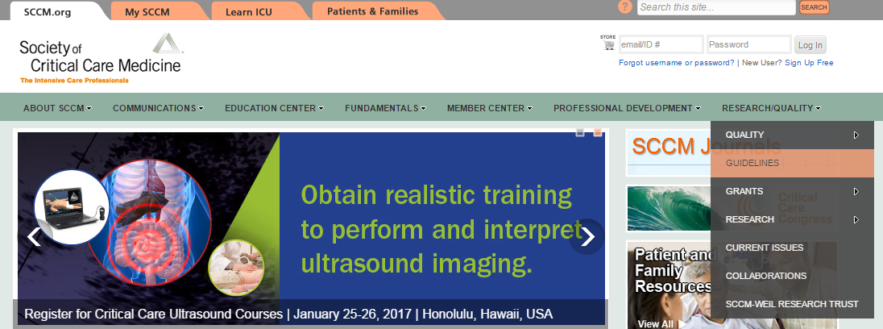
How to find the gap analysis tool
sccm.org
Notes:
Log into sccm.org
Click research/quality
Click guidelines

Slide 33
What is the evidence?
Assisting with care
2 RCTs in neonates
No RCTs in children or adults
Few single center observational or qualitative studies
Surveys suggest >80% willing to engage
Educating Families

Slide 34
The Evolution of “Family” in the Care of Critically Ill Patients
ERA
Families’ Experience
Family Satisfaction with ICU
(FS-ICU 24R)
SCCM Guidelines for Family-Centered Care in the ICU
Family Centered
Care
Family as “Partners’
Improving Partnerships with Family Members of ICU Patients: The IMPACT Trial

Slide 35


Slide 36
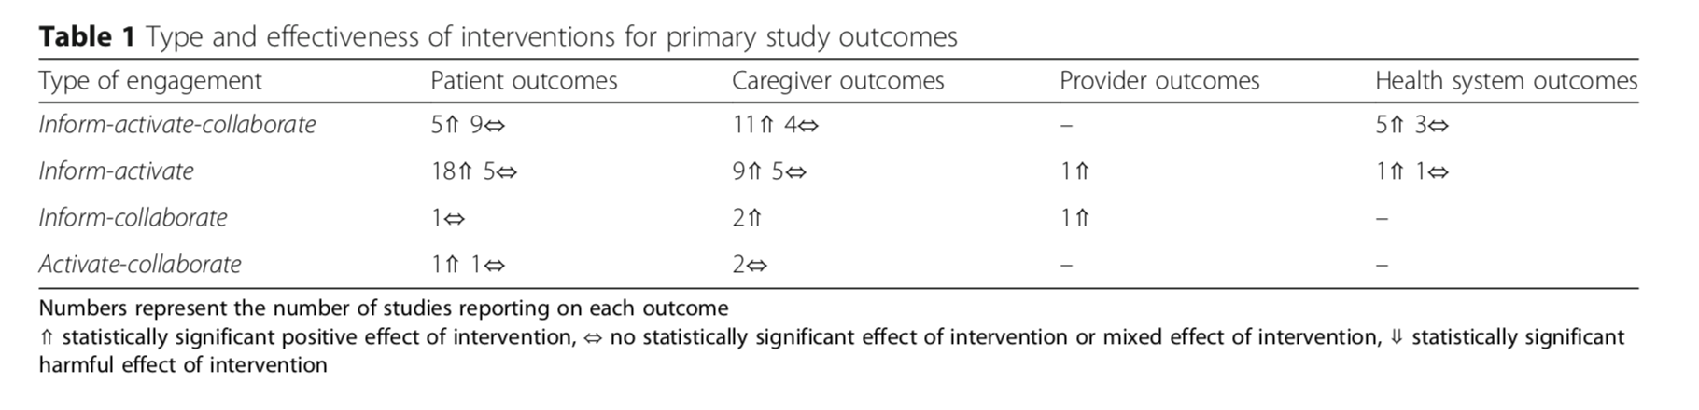
Evidence that Partnering with Family Caregivers Impacts Outcomes
56 studies of caregiver-mediated interventions¹
There is a large body of research, including many RCTs, to support the use of caregiver-mediated interventions that inform and activate caregivers to improve patient and caregiver outcomes.
Authors recommend consideration inform-activate-collaborate interventions when implementing patient and family-oriented research.
¹ Fiest BMC 2014

Slide 37
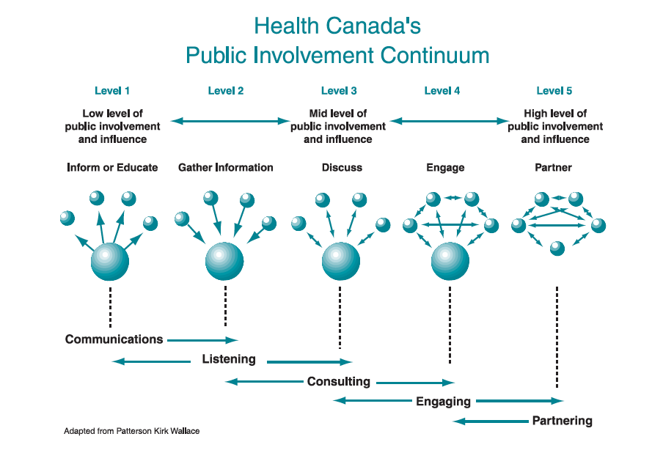
What do we mean by engagement and partnership?
Health Canada. 2000. Policy toolkit for public involvement in decision making.

Slide 38
Why Partner with Families of ICU Patients?
Families of critically ill patients
  They are the one constant across the continuum of care
  Provide significant direct care to surviving patients
    Estimated at >$642 Billion per year in costs ²
  Suffer from significant mental health issues including depression¹
¹ Cameron NEJM 2016;374:1831-1841
² Chari Health Serv Res 2015;50:871-82

Slide 39
Theoretical Framework
Facilitated Sensemaking:
  Families need to make sense of
    What has happened
    Their new role of caregiver of a critically ill pt
  Family engagement in decision-making and care may
    ↓ family fear, horror, and helplessness that leads to stress disorders
    ↑ pt medical condition through advocacy and loving care
    Improve family psychological outcomes long-term
Davidson Critical Care Nursing Quarterly 2010;33(2):177-189.

Slide 40
Conceptual Model for Family Engagement In the ICU
?

Slide 41
Partnering with Patient and their Families
Partnering with families members of critically ill patients has been shown to
  decrease patient anxiety, confusion and agitation,
  reduce cardiovascular complications,
  decrease length of stay in the ICU,
  make the patient feel more secure and
  increase patient satisfaction.
Reduces family stress
Overall, it is thought to promote quality and safety in the ICU.
But do we know how best to partner with families?

Slide 42

REALISTIC-80
Overall Design
All 80+ admitted to participating ICU >24 hrs and had a family member present
610 Enrolled
ICU 80+ Patients and their families
3,6,9,12 Month Outcomes
Inclusion criteria:
>24 hrs in ICU
Family present
Heyland Crit Care Med 2015; Palliative Med 2015; Intensive Care Med 2016

Slide 43
Conclusions (1)
One in four very elderly patients who are admitted to ICU will die in hospital; many after a prolonged stay in ICU.
Very elderly patients admitted to ICU have a low probability of being alive and returning to prior levels of physical function at 12 months.
Baseline PF and Frailty Index are significant risk factors and consideration should be given to routinely measuring them in older patients admitted to ICU in addition to traditional measure describing the acute illness.

Slide 44
Conclusions (2)
There is incongruity between family members’ values and preferences for end of life care of their very elderly relatives and the actual care received.
Deficiencies in communication and decision-making may be associated with non-beneficial and prolonged use of life-sustaining treatments in very elderly critically ill patients, many of whom ultimately die.
These findings raise concerns about the quality of care provided to these patients and their families at the end of life.
“My Dad died in the ICU. No one told me how serious he was. I wasn’t really ready for it.”
Family member

Slide 45

Conceptual Framework for End of Life Decisions
Resuscitation or WLS?
Characteristics
Age, Race, Gender, Capacity, Willingness to Discuss
Attitude, Knowledge, Values, Preferences, Perceptions
Symptoms, Quality of Life,
Wealth, Insurance
Characteristics
Age, Gender, Profession, Years of Practice,
Attitude, Knowledge, Values , Preferences,
Training, Communication Strategies
Patient
Provider
1) Info exchange
2) Deliberation
3) Decisional Responsibility
Environmental
Timing
Barriers
Institutional policies
Surrogate
Characteristics
Relationship, Attitude, Knowledge, Values, Preferences, Perceptions, Insurance, Wealth

Slide 46
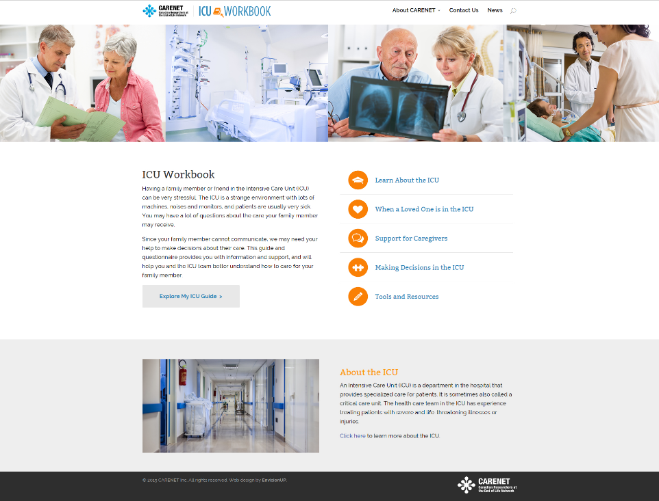
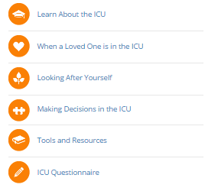
www.myicuguide.ca

Slide 47
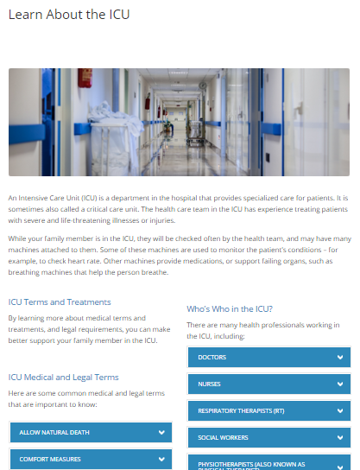
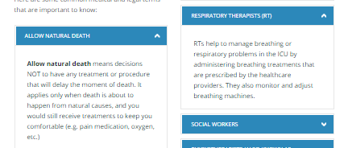
Definitions in lay terms for :
12 medical/legal terms
10 ICU roles
26 ICU treatments

Slide 48
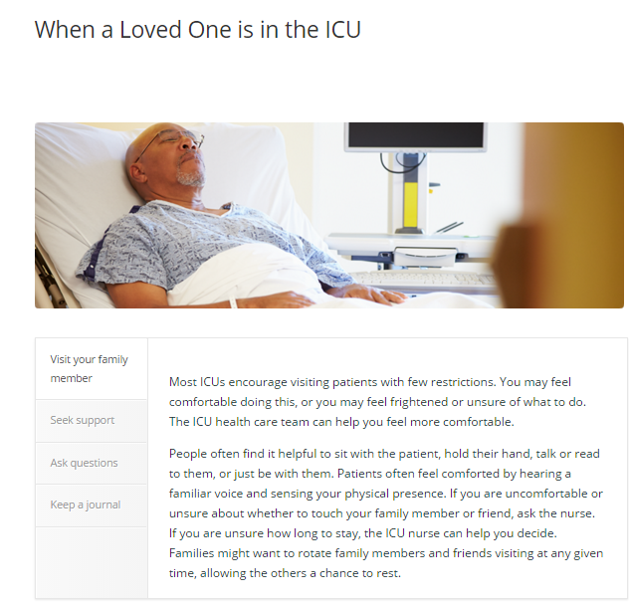
4 tabs to scroll through

Slide 49
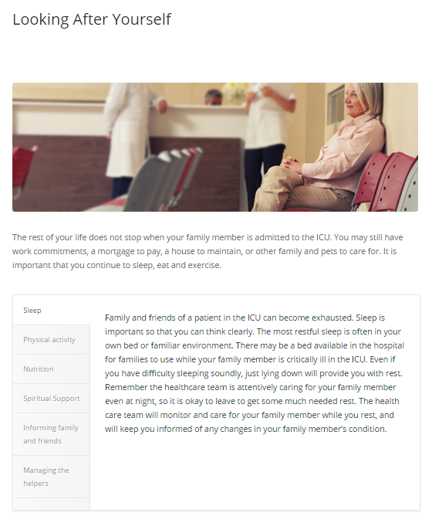
6 tabs to scroll through

Slide 50
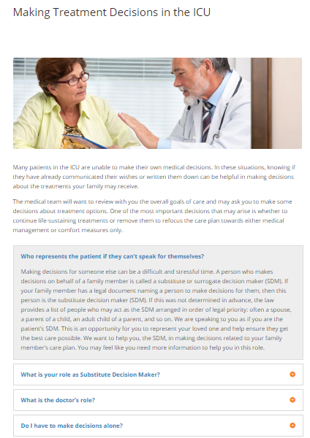
Click to expand

Slide 51
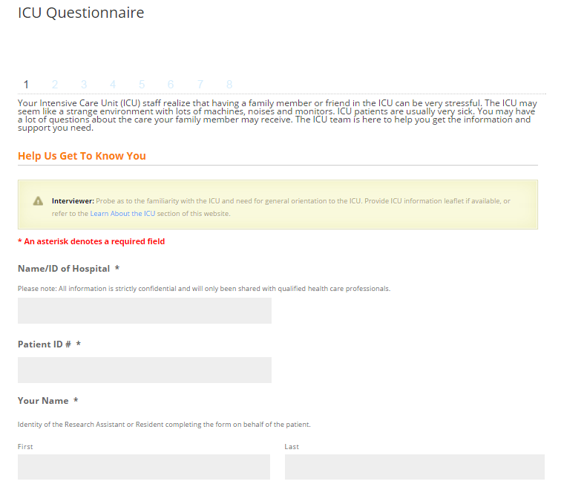

Slide 52
Example of output from MY ICU Guide that would go onto medical record
Notes:
Need to update this slide

Slide 53
Pilot Study
2 sites in Pennsylvania (LJ Van Scoy)
30 families of critically ill patients
No major issues
  Consent failure rate around 25%
  Acceptable to families
  Up to 2 hrs to walk thru website but ‘evaluation’ added lots of time
Effect on quality EOL care and family centered- outcomes?

Slide 54

Improving Partnerships with Family Members of ICU Patients:
The IMPACT Trial
Overall Study Design
Nutrition Intervention
(OPTICS)
150 Eligible ‘high-risk’ patients and their family member
Process Measures and Short-term outcomes
R
Decision Support Intervention
(My ICU Guide)
Usual Care
119 Patients enrolled to date
Heyland Trials 2018

Slide 55
In Summary…
A Evolution in the “Family” in Critical Care
ERA
Families’ Experience
Family Satisfaction with ICU
(FS-ICU 24R)
SCCM Guidelines for Family-Centered Care in the ICU
Family Centered
Care
Family as “Partners’
Improving Partnerships with Family Members of ICU Patients: The IMPACT Trial

Slide 56
Discussion Points
Do you think this is a ‘game-changer’? That we can use families to drive process improvement?
Can we improve patient and family outcomes by engaging families as partners?
Can we harness the passion/energy of current or past ‘families’ to drive policy change?
What additional resources/tools might help families function as advocates for best practice?
Others?

Slide 57
Questions

