Slide 1


The Evolution of “Family” in the Care of Critically-lll Patient
Daren K. Heyland
Professor of Medicine
Queen’s University, Kingston General Hospital
Kingston, ON Canada

Slide 2



Slide 3
The Evolution of “Family” in the Care of Critically Ill Patients
ERA
Families’ Experience
Family Satisfaction with ICU (FS-ICU)
Critical Care Family Needs Inventory (CCFNI)
SCCM Guidelines for Family-Centered Care in the ICU
Family Centered
Care
Family as “Partners’
Improving Partnerships with Family Members of ICU Patients: The IMPACT Trial
Family Engagement Survey

Slide 4
Conceptual Framework for Quality of Care
PATIENT FACTORS
STRUCTURE AND PROCESSES OF CARE
OUTCOMES
PERSONAL AND SOCIAL ENVIRONMENT
Patient and Family situation
Clinical status, casemix
Social support for patient
Social support for family
STRUCTURE OF CARE
Access to care within system
Organization of care
Formal support services available
Physical environment(s) of care
PROCESS OF CARE WITH PHYSICIANS, NURSES, SOCIAL WORKERS
Technical processes with patient
Decision-making processes with patient and family
Information, counseling of patient and family
Interpersonal and communication style with patient and family
SATISFACTION WITH HEALTH CARE
Patient satisfaction with care
Family satisfaction with care
QUALITY AND LENGTH OF LIFE
Quality of life of patient
Quality of life of family and loved ones
Quality of dying of patient
Length of life
Stewart J Pain and Symptom Management 1999:17:93

Slide 5
Why Measure Family Satisfaction?
Patient and family centered outcomes recognized as important outcome measures
Increasing accountability for public use of funds in health care sector
Traditional measures (adjusted mortality rates, LOS) do not tell the whole story

Slide 6

When performance is measured,
performance improves.
When performance is
measured and reported back,
the rate of improvement accelerates.
Thomas Monson

Slide 7

A Critical Incident

Slide 8
Family Satisfaction in the ICU:
Conceptual Development
Items generated from published studies related to:
  Patient satisfaction
  Quality end of life care
  Existing literature on family (dis)satisfaction
  Medical decision making

Slide 9
How are we doing?
Your opinions about your family member’s recent admission to the Intensive Care Unit (ICU)
Your family member was a patient in the ICU at the Kingston General Hospital. You have been recorded as being the “next-of-kin”. The questions that follow ask YOU about your family member’s most recent ICU admission. We understand that there were probably many doctors and nurses and other staff involved in caring for your family member. We know that there may be exceptions but we are interested in your overall assessment of the quality of care we delivered. We understand that this was probably a very difficult time for you and your family members. We would appreciate you taking the time to provide us with your opinion. Please take a moment to tell us what we did well and what we can do to make our ICU better. Please be assured that all responses are confidential. The Doctors and Nurses who looked after your family member will not be able to identify your responses.
PART 1: SATISFACTION WITH CARE
Please check one box that best reflects your views. If the question does not apply to your family member’s stay then check the not applicable box (N/A).
HOW DID WE TREAT YOUR
FAMILY MEMBER
(THE PATIENT)
1.
Concern and Caring by ICU Staff:
The courtesy, respect and compassion your family member
(the patient) was given
1
2
3
4
5
6
Excellent
Very Good
Good
Fair
Poor
N/A
Heyland J Crit Care 2002:16:142

Slide 10
Family Satisfaction Benchmarked Site Report

Slide 11
Family Satisfaction Benchmarked Site Report

Slide 12
Family Satisfaction Benchmarked Site Report

Slide 13
Targets for Quality Improvement
Focus on the items considered ‘most important’ and families are ‘least satisfied’ (Quadrant A)

Slide 14
Don’t forget to capture the stories!

Slide 15

My Quality Improvement Motto
Facts provide us with knowledge;
Stories provide us with the power to transform care!

Slide 16



www.thecarenet.ca/familysatisfaction

Slide 17
Family Satisfaction in the ICU (FS-ICU)
Most popular and rigorously developed questionnaire to measure the family’s experience
2 versions
  FSICU-24
  FSICU-34
>30 published studies
Translated and/or culturally adapted to 15 languages
Existing databases used to provide bench-marking
For more information, see www.thecarenet.ca

Slide 19
Family Satisfaction in the ICU (FS-ICU)
Limitations
Does not measure family satisfaction with the following:
  Presence and involvement in daily ward rounds
  Participation in care

Slide 20
Before and after study in Hong-Kong ICU
Used CCFNI to assess family needs within 72 hours of admission and developed a ‘tailor-made’ educational intervention to meet unmet needs
Most of the families needed more information and assurances
Intervention results in decreased anxiety and higher levels of satisfaction

Slide 21
A Evolution in the “Family” in Critical Care
ERA
Families’ Experience
Family Satisfaction with ICU (FS-ICU)
Critical Care Family Needs Inventory (CCFNI)
SCCM Guidelines for Family-Centered Care in the ICU
Family Centered
Care
Family as “Partners’
Improving Partnerships with Family Members of ICU Patients: The IMPACT Trial
Family Engagement Survey

Slide 22
The Institute of Medicine defines quality care as safe, timely, efficient, effective, equitable, and patient-centered
In the ICU, patient-centeredness includes family-centeredness

Slide 23
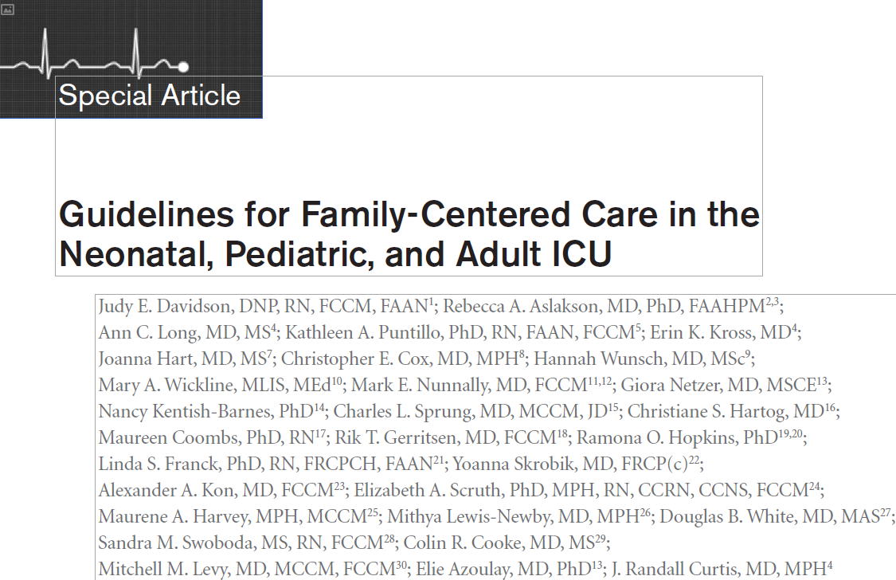
Davidson CCM 2017 Jan epub

Slide 24
Definitions
Family is defined by the patient or, in the case of minors or those without decision-making capacity, by their surrogates. In this context, the family may be related or unrelated to the patient. They are individuals who provide support and with whom the patient has a significant relationship.
Family-centered care is an approach to health care that is respectful of and responsive to individual families’ needs and values.
Notes:
Notice that we defined family-centered care. The scope of these guidelines are to explain best practices in caring for the family members of ICU patients. It is not how to provide person-centered care, which would have been a project much larger in scope.
We purposefully focused as tightly as possible on how to provide care that is family oriented.
We purposefully reached out to the LGTBQ community to assure that the definitions would work across the gender spectrum

Slide 25
Guidelines for Family-Centered Care in the ICU
Reviewed 286 qualitative and quantitative papers
Summarized data across numerous topics
Generated 23 recommendations
All recommendations were ‘weak’ highlighted the nascence of this field of research
Important to generate new research to strengthen the evidentiary foundation
Davidson CCM 2017 Jan epub

Slide 26
Guidelines for Family-Centered Care in the ICU
Family Presence in the ICU
Families be offered
  Open and flexible family presence
  Option to participate in rounds
  Option of being present during resuscitation efforts
Davidson CCM 2017 Jan epub

Slide 27
Guidelines for Family-Centered Care in the ICU
Family Support
Family education programs be included as part of clinical care
Peer to peer support be implemented
ICUs provide families with leaflets that give information about the ICU setting to reduce family member anxiety and stress
Davidson CCM 2017 Jan epub

Slide 28
Guidelines for Family-Centered Care in the ICU
Family Support cont’d
ICU diaries be implemented
Validated decision support tools be implemented to optimize quality of communication, comprehension and reduce decisional conflict
Amongst surrogates of ICU deemed to have poor prognosis, clinicians use a structured communications approach (such as VALUES)
Davidson CCM 2017 Jan epub

Slide 29
Guidelines for Family-Centered Care in the ICU
Communication with family members
Routine interdisciplinary family conference
Structured approaches to communication
For family members of patients who are dying, offered a written bereavement brochure
ICU clinicians receive family-centered communication training as part of their core critical care training
Davidson CCM 2017 Jan epub

Slide 30
Guidelines for Family-Centered Care in the ICU
Use of specific consultation and ICU team members
Proactive palliative care consultation among selected patients with poor prognosis
Ethics consults for whom there is value-related conflict
Social workers be included and participate in family meetings
Family navigators (care coordinator or communication facilitator
Spiritual support where needed
Davidson CCM 2017 Jan epub

Slide 31
Guidelines for Family-Centered Care in the ICU
Operational and environmental issues
Protocols be implemented to ensure adequate and standardized use of sedation and analgesia during withdrawal of life supports
Nurses be involved in decision-making goals and be training to provide support in decision-making
Hospital implement policies to promote family-centered care in the ICU, reduce noise, promote hygiene, and increase use of private rooms.
Families be provided a sleep surface
Davidson CCM 2017 Jan epub

Slide 32
What is the evidence?
Assisting with care
2 RCTs in neonates
No RCTs in children or adults
Few single center observational or qualitative studies
Surveys suggest >80% willing to engage
Educating Families

Slide 33
SCCM FCC Gap Analysis Tool
A free tool that evaluates your practice against recommended practice
Creates a priority list for change
Assess barriers to change
Develop an feasible organization-specific bundle to enhance FCC in your ICU
Notes:
This tool will help you build an ICU or organization-specific bundle for action-planning.

Slide 34
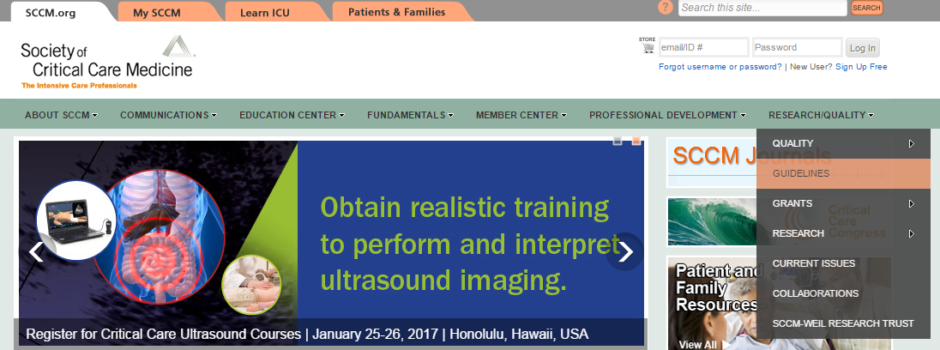
How to find the gap analysis tool
sccm.org
Notes:
Log into sccm.org
Click research/quality
Click guidelines

Slide 35
A Evolution in the “Family” in Critical Care
ERA
Families’ Experience
Family Satisfaction with ICU (FS-ICU)
Critical Care Family Needs Inventory (CCFNI)
SCCM Guidelines for Family-Centered Care in the ICU
Family Centered
Care
Family as “Partners’
Improving Partnerships with Family Members of ICU Patients: The IMPACT Trial
Family Engagement Survey

Slide 36
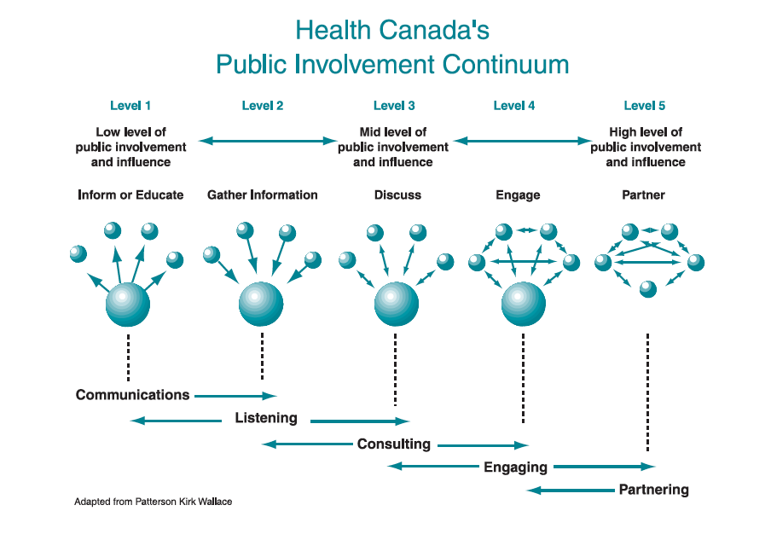
What do we mean by engagement and partnership?
Health Canada. 2000. Policy toolkit for public involvement in decision making.

Slide 37
Why Partner with Families of ICU Patients?
Families of critically ill patients
  They are the one constant across the continuum of care
  Provide significant direct care to surviving patients
    Estimated at >$642 Billion per year in costs ²
  Suffer from significant mental health issues including depression¹
¹ Cameron NEJM 2016;374:1831-1841
² Chari Health Serv Res 2015;50:871-82

Slide 38
Theoretical Framework
Facilitated Sensemaking:
  Families need to make sense of
    What has happened
    Their new role of caregiver of a critically ill pt
  Family engagement in decision-making and care may
    ↓ family fear, horror, and helplessness that leads to stress disorders
    ↑ pt medical condition through advocacy and loving care
    Improve family psychological outcomes long-term
Davidson Critical Care Nursing Quarterly 2010;33(2):177-189.

Slide 39
Conceptual Model for Family Engagement In the ICU
?

Slide 40
Partnering with Patient and their Families
Partnering with families members of critically ill patients has been shown to
  decrease patient anxiety, confusion and agitation,
  reduce cardiovascular complications,
  decrease length of stay in the ICU,
  make the patient feel more secure and
  increase patient satisfaction.
Reduces family stress
Overall, it is thought to promote quality and safety in the ICU.
But do we know how best to partner with families?

Slide 41

Improving Partnerships with Family Members of ICU Patients:
The IMPACT Trial
Overall Study Design
Nutrition Intervention
(OPTICS)
150 Eligible ‘high-risk’ patients and their family member
Process Measures and Short-term outcomes
R
Decision Support Intervention
(My ICU Guide)
Usual Care

Slide 42
The Nutrition Intervention
OPTimal nutrition by Informing and Capacitating family members of best practices (OPTICs)

Slide 43

Optimal Nutrition (>80%) is associated with Optimal Outcomes!
(For High Risk Patients)
If you feed them (better!)
They will leave (sooner!)

Slide 44
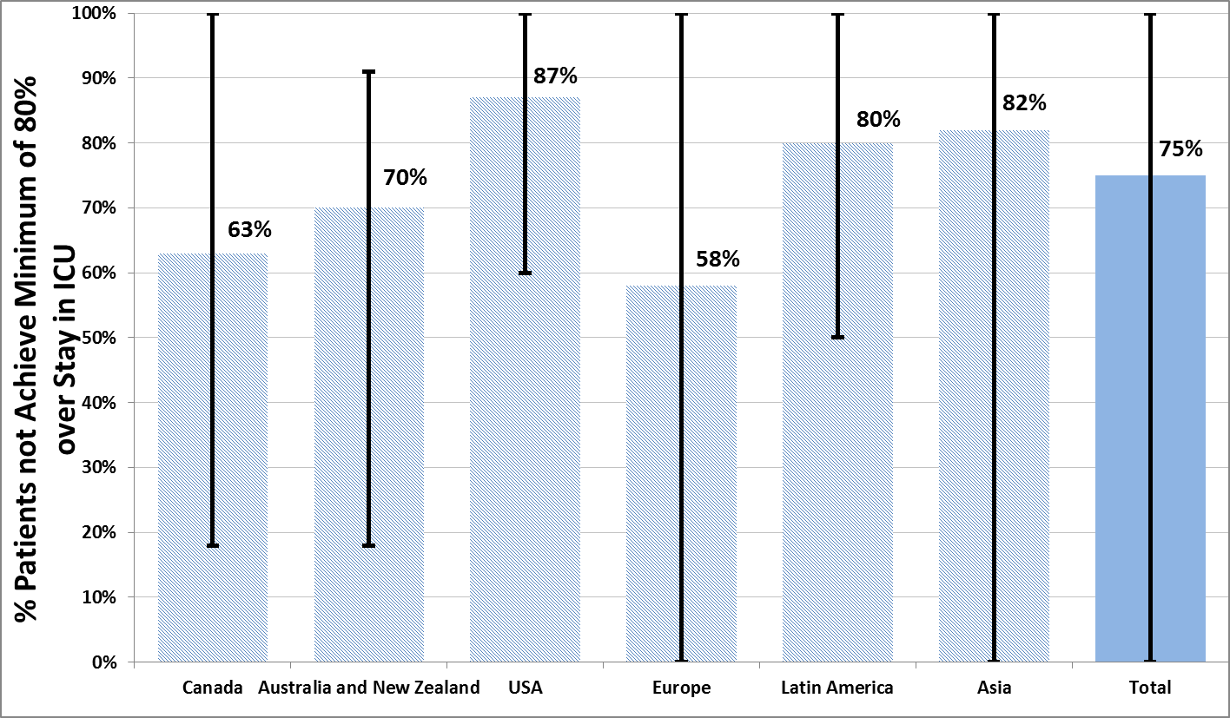
Failure Rate
The Prevalence of Iatrogenic Underfeeding
in the Nutritionally ‘At-Risk’ Critically Ill Patient
% high risk patients who failed to meet minimal quality targets (80% overall energy adequacy)
Of all at-risk patients, 14% were ever prescribed volume-based feeds
15% ever received sPN
Heyland
Clinical Nutrition 2015

Slide 45
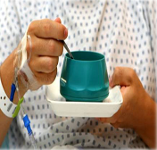
Malnutrition and underfeeding
across the continuum of care
Hospitalized patients:
- approximately 31-45% are malnourished
  Protein/energy depletion and poor patient outcomes
ICU patients:
  Increased risk of malnutrition
  nutrition adequacy is poor, hypercatabolic state, poor delivery, intolerance
  Can result in prolonged stay in ICU, health care costs and higher mortality
Post ICU: oral intake post extubation is inadequate (Peterson JADA 2010)
Post hospital syndrome: vulnerable period is 30 days after hospital discharge (Krumholz NEJM 2013)

Slide 46
Understanding Adherence to Guidelines in the ICU:
Development of a Comprehensive Framework
CPG
Characteristics
ADHERENCE
Patient Characteristics
Implementation Process
Institutional Factors
Provider Intent
Provider Characteristics
- Profession
Critical care expertise
Educational background
Personality
System
characteristics
Hospital
characteristics
Structure
Processes
Resources
Knowledge
Attitudes
Familiarity
Agreement
Outcome
expectancy
ICU
characteristics
Structure
Processes
Resources
Culture
Jones N, Heyland DK
JPEN Nov 2010
Awareness
Motivation
Self-efficacy

Slide 47


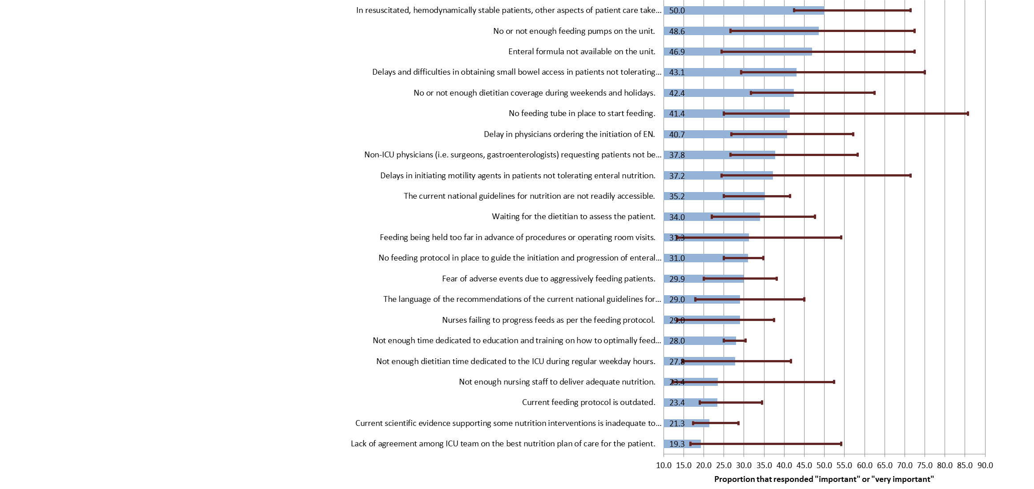
Top Barriers to Enteral Feeding
Cahill J Crit Care 2012 27(6):727-734

Slide 48
A Quotable Quote
“With critical illness, nutrition is often one of the last things on the minds of the health care team….”
Nurse in OPTICS study
How do we change the culture and make nutrition a higher priority?
Airway, Breathing, Circulation,
D(Digestion), E(Early EN)

Slide 49
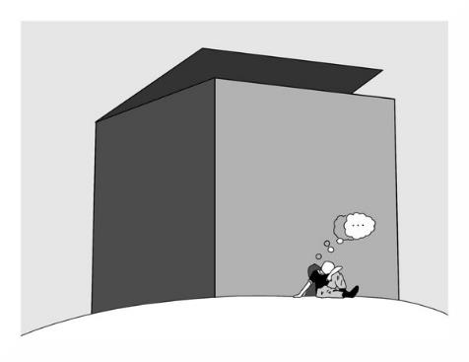
What can we do differently to change performance?
The same thinking that got you into this mess won’t get you out of it!

Slide 50

Overall Hypothesis
Educating families about the importance of nutrition and capacitating them advocate for better nutrition for their loved one in the ICU will result in better nutrition delivery during critical illness and in the recovery phase

Slide 51
OPTimal Nutrition by Informing and Capacitating Family Members of Best Practices
A multifaceted intervention
Family Facing
Health Care Professional Facing
Educational sessions after ICU admission and on transfer to ward
Educational Booklet and videos
Instructional video
Nutrition Diary tool
Dietitian Support thru out
Nutrition discharge plan
Dietitian led engagement
  Obtaining nutrition history
  Providing educational sessions in ICU and ward
  Responsible for developing care plan and handover to ward staff
  Introduce Nutrition Diary tool
  Follow up in ICU and on ward
  Nutrition discharge plan for home
3-day calorie counts
Training materials (NIBBLES) for other HCP on nutrition and recovery
Orientation to the family facing materials
Posters/info graphics

Slide 52
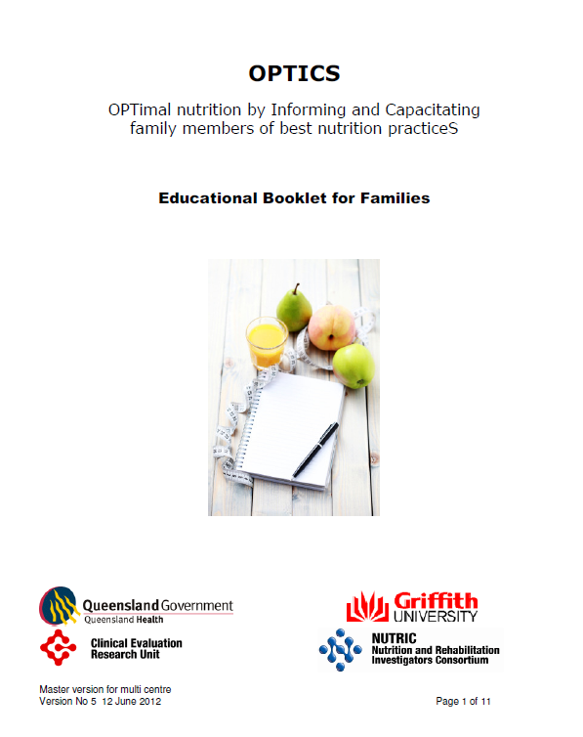

Slide 53
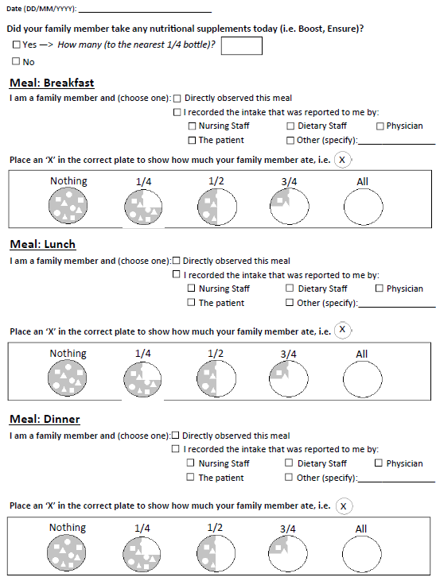
Nutrition Diary

Slide 54
Results of a Multi-center Pilot Study
Primary Outcomes
assess the feasibility of the intervention
  recruitment: ability to recruit participants in a timely manner
  retention: >80% of patients and families in the study until hospital d/c
assess the acceptability of the intervention
  families: > 80% of families view the intervention as acceptable and that they would be willing to participate again
  HCPs: >80% of HCPs viewed the intervention as being positive (wrt family interactions, burden on the family and improvements in patient outcomes)
Lots of feedback helped develop and refine the intervention and outcome measures

Slide 55
Results of a Multi-center Pilot Study
Anecdotes from families
Some ward staff “don’t seem to take as much interest in [nutrition]” and concern was expressed that nutrition intake was not closely monitored.
“… the same little lady that brought [meal trays] in would whisk them away. Nobody would have known whether [the patient] ate or not. Consequently some families felt the need to be vigilant about nutrition intake in the period post ICU discharge, to the extent that they would coordinate visiting to coincide with meals to ensure that the patient was eating.”
Another commented that advocating for nutrition was “useless” because “the hospital itself doesn't follow up…most meals were just thrown in, picked up and taken out.”

Slide 56
Results of a Multi-center Pilot Study
Anecdotes from families
Families were positive about their involvement in the intervention and described feeling comfortable asking questions while the patient was in ICU.
Many described their participation in the study as providing them with the “opportunity to ask questions legitimately” even on matters unrelated to nutrition.
This perception was echoed by several nurses who also commented that the education intervention and prompts gave families “permission to ask questions” and believed this might have facilitated dialogue between families and health care providers in general

Slide 57
OPTimal Nutrition by Informing and Capacitating Family Members of Best Practices
A multifaceted intervention
Family Facing
Health Care Professional Facing
Dietitian led engagement
  Obtaining nutrition history
  Providing educational sessions in ICU and ward
  Responsible for developing care plan and handover to ward staff
  Introduce Nutrition Diary tool
  Follow up in ICU and on ward
  Nutrition discharge plan for home
3-day calorie counts
Training materials (NIBBLES) for other HCP on nutrition and recovery
Orientation to the family facing materials
Posters/info graphics
Educational sessions after ICU admission and on transfer to ward
Educational Booklet and videos
Instructional video
Nutrition Diary tool
Dietitian Support thru out
Nutrition discharge plan
Effect on nutritional and clinical outcomes?

Slide 58

Greatest Improvements in EOL Care
Improving EOL communication and decision making

Slide 59
Purpose of Information Exchange
Prognosis
+
Values
Good Decision
What do we know about the outcomes of the very elderly critically ill patient?

Slide 60

REALISTIC-80
Overall Design
All 80+ admitted to participating ICU >24 hrs and had a family member present
610 Enrolled
ICU 80+ Patients and their families
3,6,9,12 Month Outcomes
Inclusion criteria:
>24 hrs in ICU
Family present
Heyland Crit Care Med 2015; Palliative Med 2015; Intensive Care Med 2016

Slide 61
Conclusions (1)
One in four very elderly patients who are admitted to ICU will die in hospital; many after a prolonged stay in ICU.
Very elderly patients admitted to ICU have a low probability of being alive and returning to prior levels of physical function at 12 months.
Baseline PF and Frailty Index are significant risk factors and consideration should be given to routinely measuring them in older patients admitted to ICU in addition to traditional measure describing the acute illness.

Slide 62
Conclusions (2)
There is incongruity between family members’ values and preferences for end of life care of their very elderly relatives and the actual care received.
Deficiencies in communication and decision-making may be associated with non-beneficial and prolonged use of life-sustaining treatments in very elderly critically ill patients, many of whom ultimately die.
These findings raise concerns about the quality of care provided to these patients and their families at the end of life.
“My Dad died in the ICU. No one told me how serious he was. I wasn’t really ready for it.”
Family member

Slide 63


www.myicuguide.ca

Slide 64
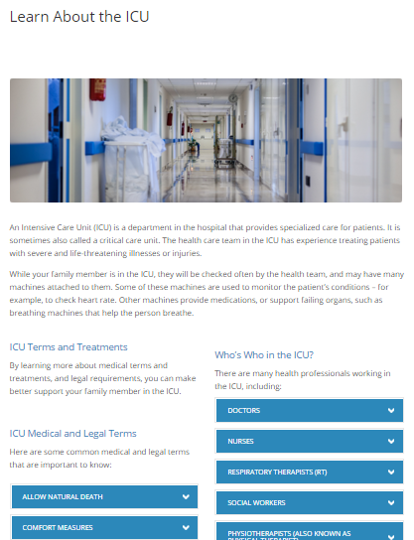
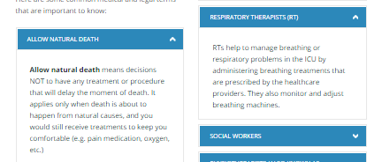
Definitions in lay terms for :
12 medical/legal terms
10 ICU roles
26 ICU treatments

Slide 65
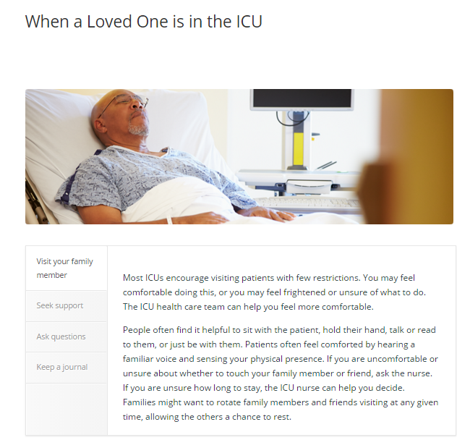
4 tabs to scroll through

Slide 66
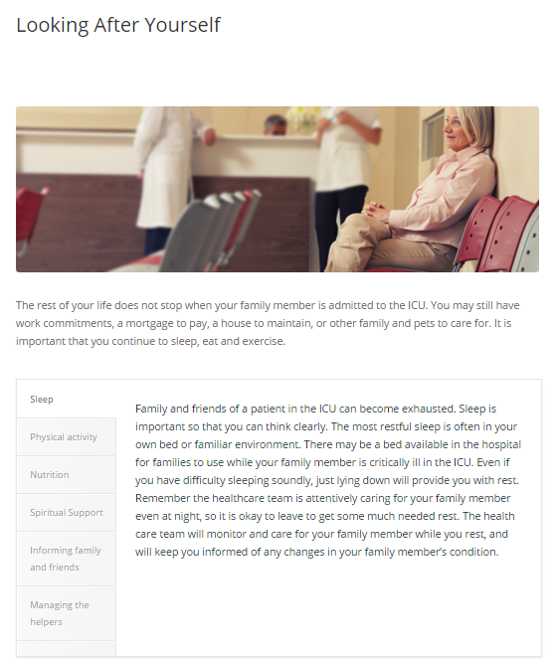
6 tabs to scroll through

Slide 67
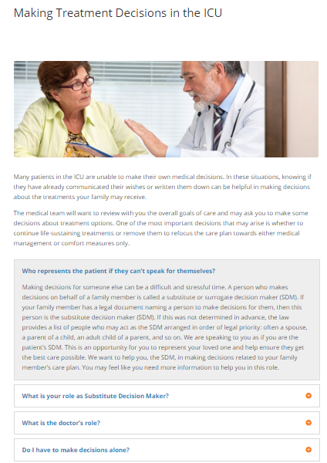
Click to expand

Slide 68
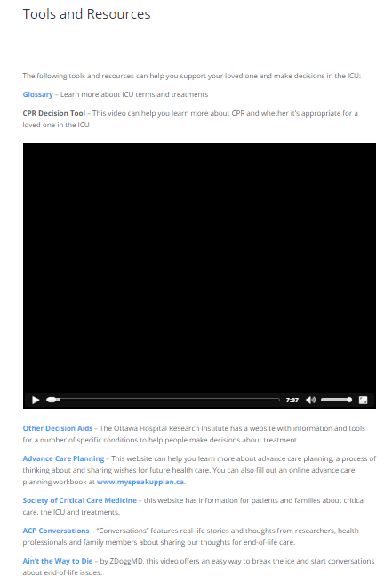
7 minute video

Slide 69
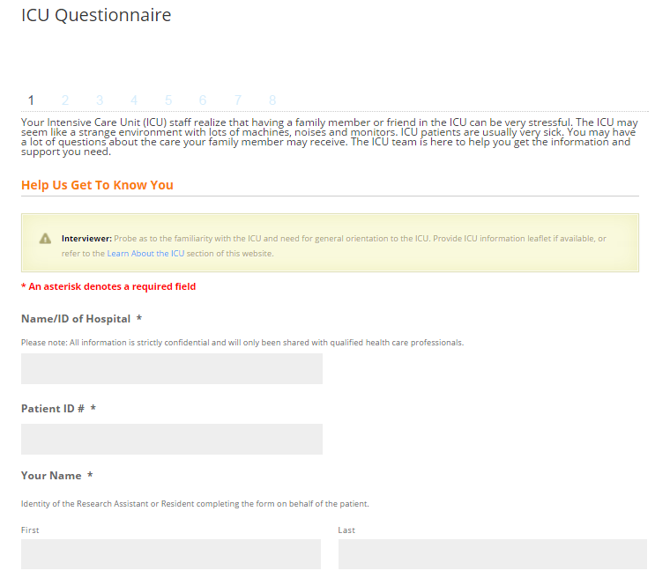

Slide 70
Example of output from MY ICU Guide that would go onto medical record
Notes:
Need to update this slide

Slide 71
Pilot Study
2 sites in Pennsylvania (LJ Van Scoy)
30 families of critically ill patients
No major issues
  Consent failure rate around 25%
  Acceptable to families
  Up to 2 hrs to walk thru website but ‘evaluation’ added lots of time
Effect on quality EOL care and family centered- outcomes?

Slide 72
Improving Partnerships with Family Members of ICU Patients:
The IMPACT Trial
Overall Study Design
Nutrition Intervention
(OPTICS)
150 Eligible ‘high-risk’ patients and their family member
Process Measures and Short-term outcomes
R
Decision Support Intervention
(My ICU Guide)
Usual Care

Slide 73
A Novel Outcome Questionnaire
Behavior change requires change in several factors or processes including:
  knowledge or understanding of the importance of the behavior,
  contemplation of engaging in the behavior,
  self-efficacy to complete the behavior, and
  readiness to complete the behavior.
Based on these factors, individuals then proceed through a series of stages including pre-contemplation, contemplation, and preparation prior to action (changed behavior).
1 Bandura A. Self-efficacy: toward a unifying theory of behavioral change. Psychol Rev 1977;84:191-215.
2 Prochaska JO, Velicer WF. The transtheoretical model of health behavior change. Am J Health Promot 1997;12:38e48.

Slide 74
Domain and Subdomains | Behavioral Process Changes | Desired Actions/Outcomes
Nutrition care -nutritional status -negative effects of malnutrition and underfeeding -various nutritional treatment options -how to ask questions of health care professionals related to nutrition care | Knowledge Contemplation Self-Efficacy Readiness | Start thinking about nutrition in the context of serious illness Seek out related information Ask questions of health care professionals related to nutritional care of the patient
Decision-making - how decisions are made, types of treatments used in ICU (life-sustaining treatments vs. comfort care), role of SDM -ability to represent patients values and preferences -managing stress and looking after self |  | Start thinking about treatments during serious illness Seek out related information Engage in shared decision-making Adequately represents patients values and preferences Able to self-manage

Slide 75
Methodology
Item generation
  Literature review
  Underlying theoretical models
  Series of focus groups and individual consultations with experts
Acceptability and Clinical sensibility assessed in focus groups with
  Health care professionals
  Patient and family representatives
Face and content validity
Notes:
Review questionnaire (pull up word version)

Slide 78
Methodology (2)
In the context of Project IMPACT, will undergo further psychometric testing
  Missing data, ranges, floor and ceiling effects
  Internal consistency
Construct validity further assessed by adding mobility domain
  A priori, we expect the nutrition scores to be higher in the nutrition intervention group compared to the other groups, the decision support scores to be higher in the decision support intervention group compared to the other groups, and the early mobility scores to be the same across all groups.
Factor analysis?

Slide 79
In Summary…
A Evolution in the “Family” in Critical Care
ERA
Families’ Experience
Family Satisfaction with ICU (FS-ICU)
Critical Care Family Needs Inventory (CCFNI)
SCCM Guidelines for Family-Centered Care in the ICU
Family Centered
Care
Family as “Partners’
Improving Partnerships with Family Members of ICU Patients: The IMPACT Trial
Family Engagement Survey

Slide 80
Discussion Points
Do you think this is a ‘game-changer’? That we can use families to drive process improvement?
What additional resources/tools might help families function as advocates for best practice?
  App?
  Platforms? (i.e, “Patientslikeme” like platform)
  Combine with mobility training?
  Bench-marking nutrition intake or functional status?
  Others?
Can we harness the passion/energy of current or past ‘families’ to drive policy change?

Slide 81
Questions

